Slide 1
Kitchen Pilot
Your AI compliance partner for Malaysian F&B SMEs
Presented By Team AAA

Slide 2

Running a restaurant is hard.
Malaysian F&B owners are drowning in bureaucracy. From local council licenses to Halal certifications and KKM health standards, the regulatory landscape is fragmented and confusing.
The Cost of Non-Compliance
Missed renewals lead to hefty fines, operational shutdowns, and loss of reputation. Owners spend hours decoding legal jargon instead of managing their kitchen.

Slide 3
PROBLEM
Malaysian F&B SMEs face multiple compliance challenges:
icensing feels confusing and intimidating, causing delays.
Information is scattered across different agencies (KKM, Bomba, Local Council).
Owners struggle to manage multiple permits, SOPs, and documentation.

Slide 4
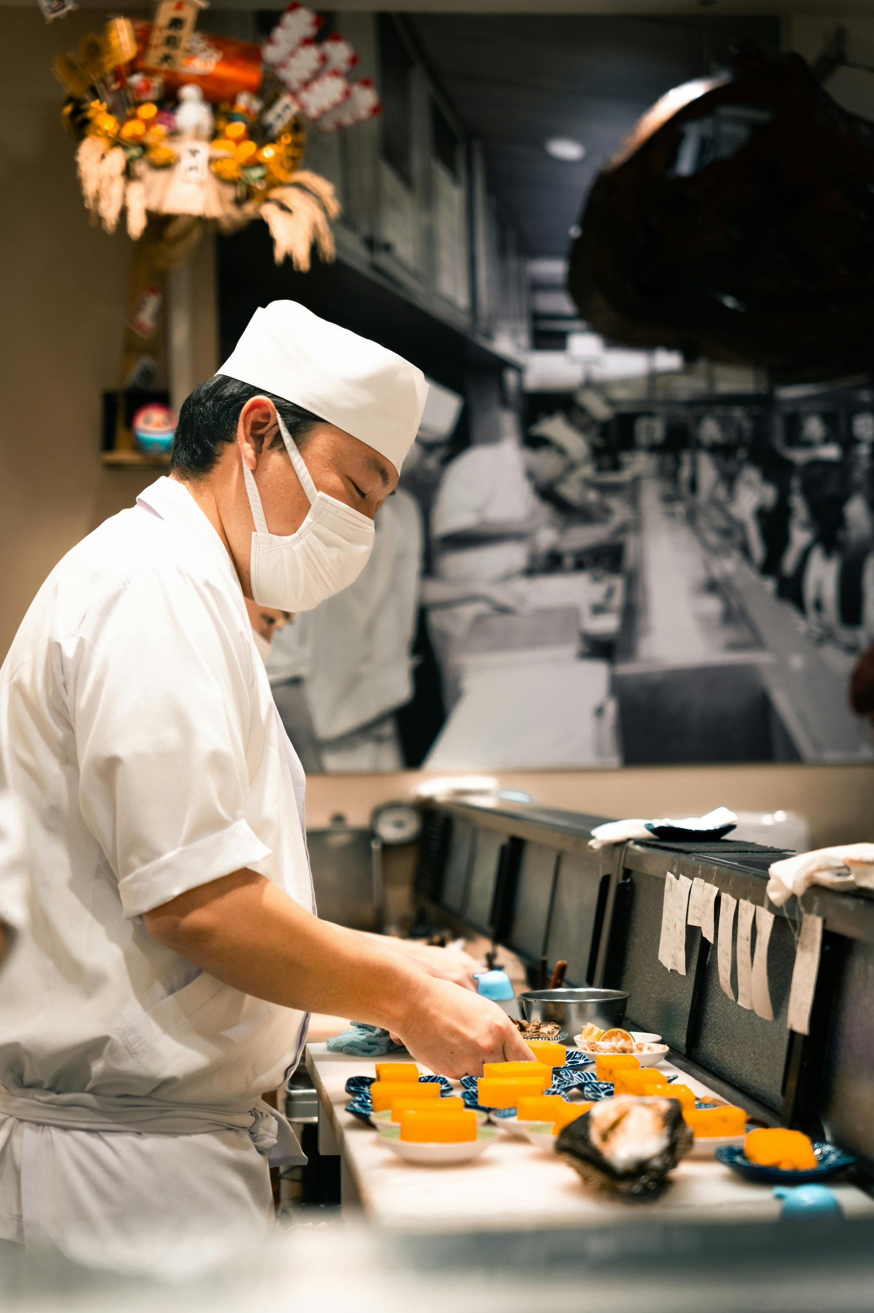
TARGET USER
Small restaurant owners, cafés,
food stalls, cloud kitchens,
home-based food sellers
who lack dedicated legal or HR teams.

Slide 5
We want to make compliance less scary and encourage SMEs to apply for the required permits early to avoid penalties and delays.
OUR SOLUTIONS

Slide 6



KEY FEATURES
Cikgu Compliance (AI Chat)
Permit Checker
Smart Auditor
AI trained on Malaysian F&B laws
RAG over DBKL, KKM, food hygiene, premise guidelines
Answers in BM & English
Automated compliance checker.
Identify missing permits like Signage or Liquor licenses
Upload SOP and optionally an official compliance doc.
AI detects missing parts.
Summaries + recommendations

Slide 7
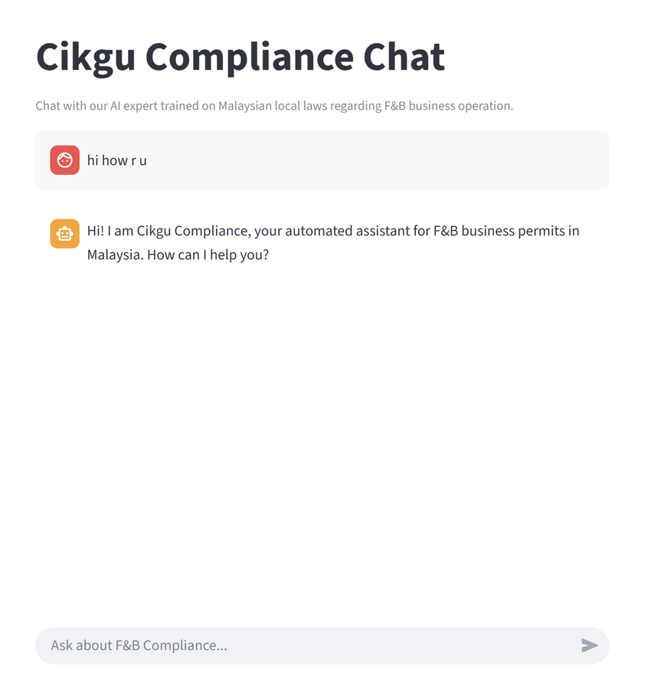
FEATURE SPOTLIGHT: CIKGU COMPLIANCE
Your Local AI Expert
Trained on local authorities, KKM, and Halal guidelines.
Understands eng/malay and local context.
Provides actionable steps, not just links.

Slide 8




TECH STACKS
Frontend
Backend
Python

Slide 9
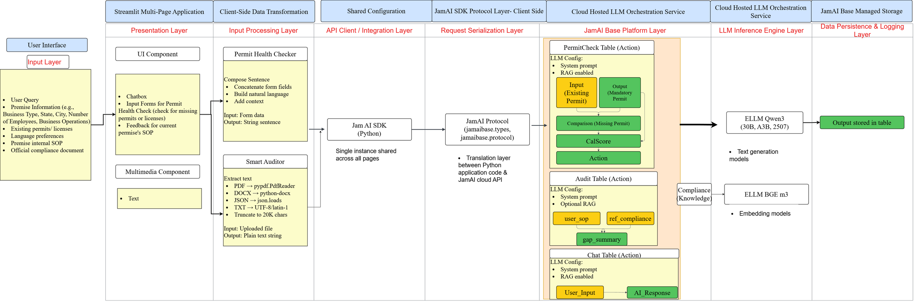
SYSTEM ARCHITECTURE

Slide 10
IMPACT
Cikgu Compliance (AI Chat)
Permit Checker
Smart Auditor
AI trained on Malaysian F&B laws
RAG over DBKL, KKM, food hygiene, premise guidelines
Answers in BM & English
Automated compliance checker.
Identify missing permits like Signage or Liquor licenses
Upload SOP and optionally an official compliance doc.
AI detects missing parts.
Summaries + recommendations

Slide 11
WHAT MAKES US DIFFERENT?
Cikgu Compliance (AI Chat)
Permit Checker
Smart Auditor
AI trained on Malaysian F&B laws
RAG over DBKL, KKM, food hygiene, premise guidelines
Answers in BM & English
Automated compliance checker.
Identify missing permits like Signage or Liquor licenses
Upload SOP and optionally an official compliance doc.
AI detects missing parts.
Summaries + recommendations

Slide 12
THANK YOU
Streamlining permits. Simplifying regulations. Focusing on food.
Presented By Team AAA

